Slide 1
REBUILDING BAYERN MÜNCHEN
A data-driven approach for Squad Reinforcement (2025-26)

Slide 2
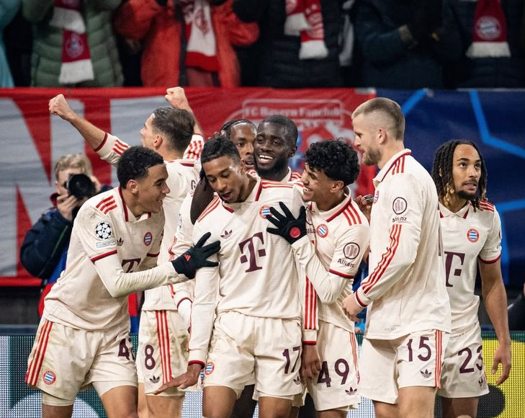
FC Bayern München
Founded in 1900, FC Bayern München is Germany’s most successful and globally renowned football club. With 33 Bundesliga titles and 6 Champions League trophies, Bayern stands as a symbol of excellence, discipline and dominance in world football.

Slide 3
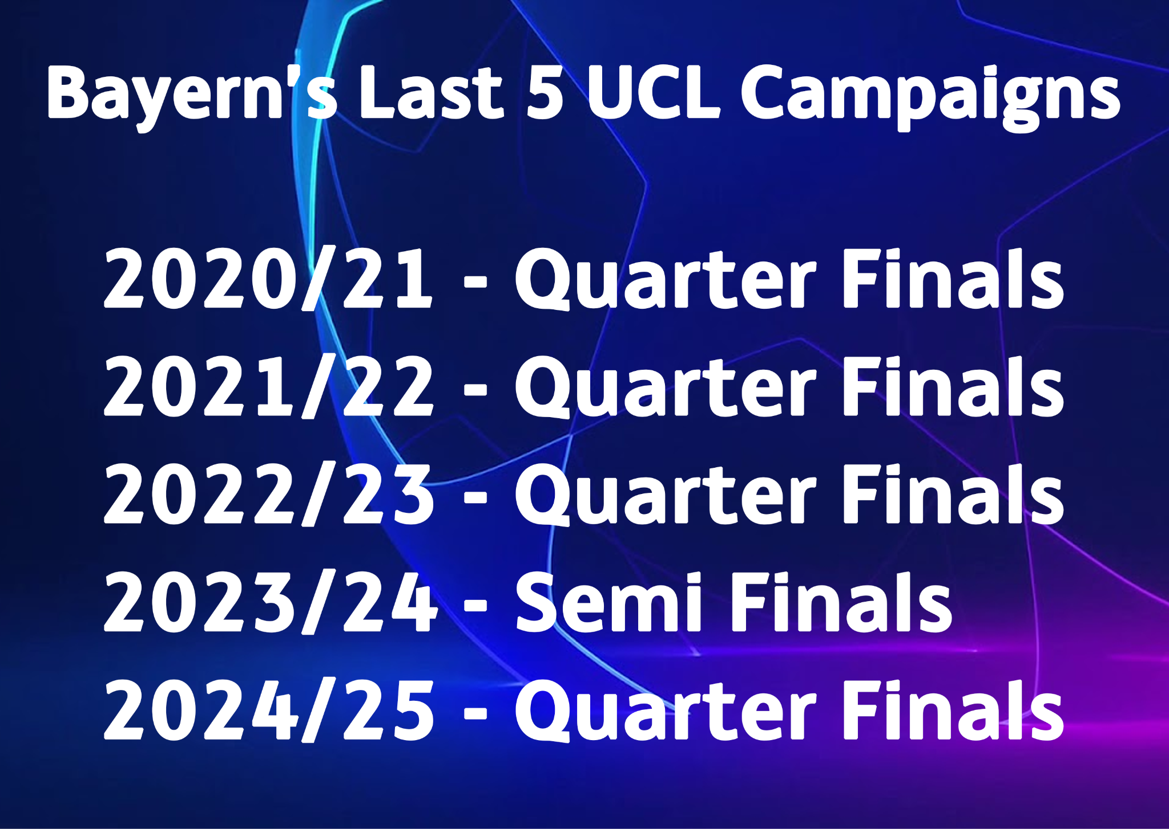
Introduction (Context & Objective)
Why is this analysis important?
🔴 Below-par Performances in Europe – Bayern’s recent UCL campaigns have fallen short of expectations, highlighting the need for smarter recruitment.
🔴 Thinning Squad Depth – Injuries and lack of versatile backups have left the team stretched across competitions.
🔴 Financial Pressure – Wage bill of €303.2m is unsustainable; club aims for a 20% reduction while maintaining squad quality.
🔴 Lack of Youth Integration – Academy talents remain underused, but integrating them can provide depth and reduce costs.

Slide 4
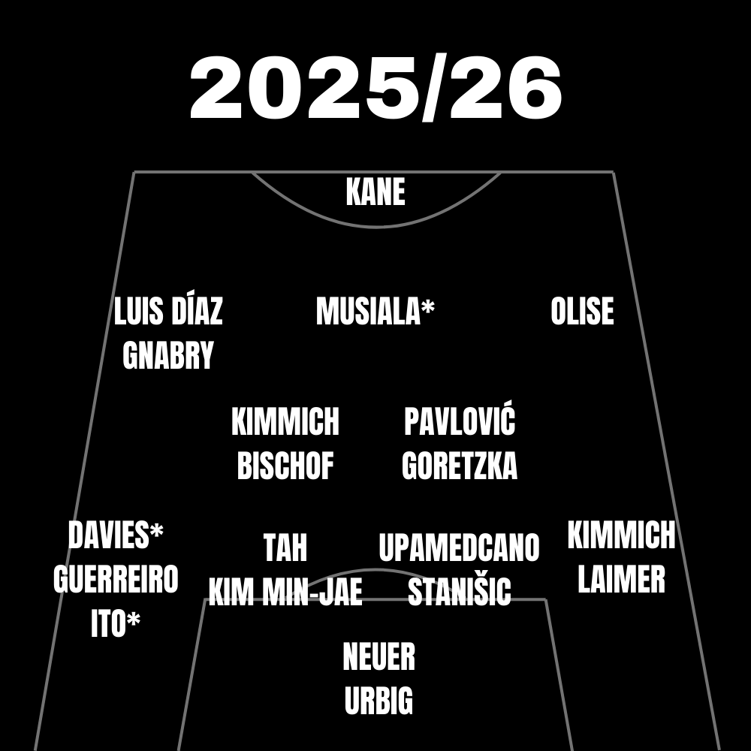
Current Squad
This is the current squad that we’re starting the 2025-26 season with, and the thin squad depth across multiple positions calls for an urgent need for recruitment and youth promotion.
* represent injuries
Squad planning analysis covers the period from August 15 onward.

Slide 5
Recommended Player Sales
Name | Position | Market Value | Wage (per year) | Reason
Guerreiro | LB | 8m | 4.24m | Ageing and declining performances
Sacha Boey | RB | 18m | 1.59m | Inconsistent, doesn’t fit tactical style
Hiroki Ito | CB | 25m | 2m | Injury prone
These players are recommended for sale to optimize squad balance, reduce wage expenditure, and align with tactical requirements. Each decision considers age, form, injury record, and fit within the team’s playing style.

Slide 6
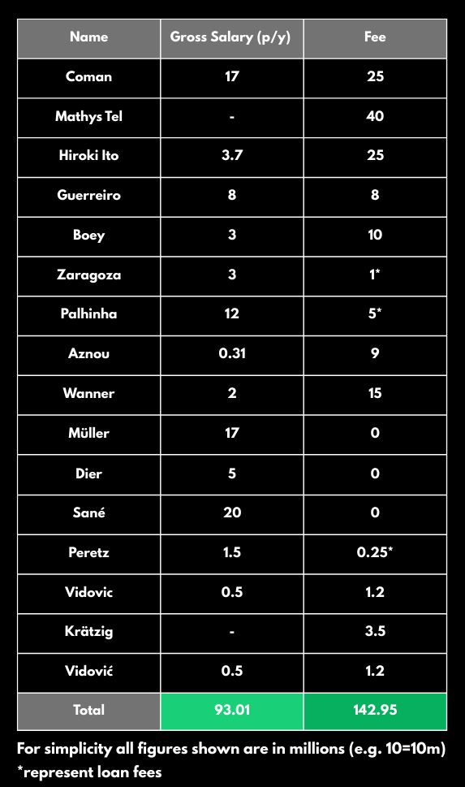
Player Departures
After the end of Transfer Window, roughly 142 million is expected to be generated and freeing up 93m from the current wage budget

Slide 7
Finding Potential Transfer targets
A data-driven approach helps identify smart transfer options to strengthen weak areas of the squad.
Currently Issues:
Thin Squad depth ➡ higher fatigue, risk of injuries
Fixture Congestion ➡ difficult to maintain performance across competitions
Positions that need recruitment:
Leftback
Rightback
Centreback
Attacking Midfielder
Striker

Slide 8
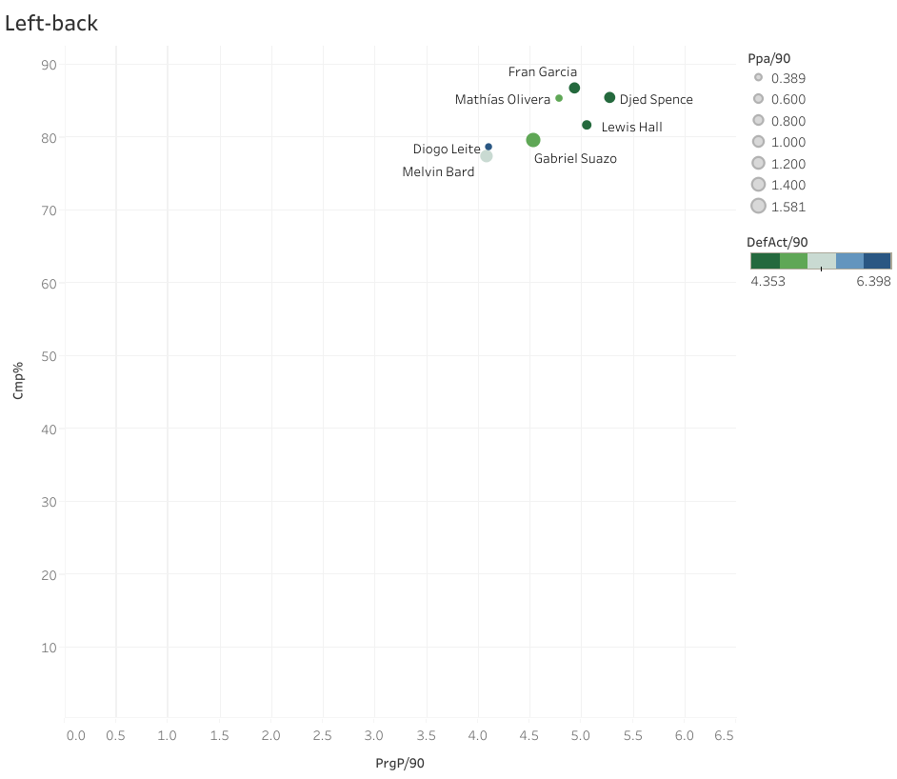
Elite Leftbacks
Using Scatter Plot to find all the elite leftbacks that can be a backup to Alphonso Davies.

Slide 9
Shortlisted Leftbacks
Out of all available leftbacks, these are identified as a transfer targets:
Lewis Hall (20, Newcastle): Before injury, one of the most productive Premier League defender. A versatile left-back, strong in progressive carries and suited a possession-heavy style.Offers solid depth with long term upside.
Djed Spence (25, Tottenham): Dynamic fullback who can operate on both flanks. Excels in 1v1s and overlapping runs, providing an aggressive forward outlet.
Fran Garcia (26, Real Madrid): Attack-minded and energetic, with high work rate and strong crossing ability. May struggle in physical duels against physical wingers.
Mathías Olivera (27, Napoli): Defensively reliable leftback, strong in duels and pressing structure. Brings top-level experience, and can compliment Davies’ attacking style when needed.

Slide 10
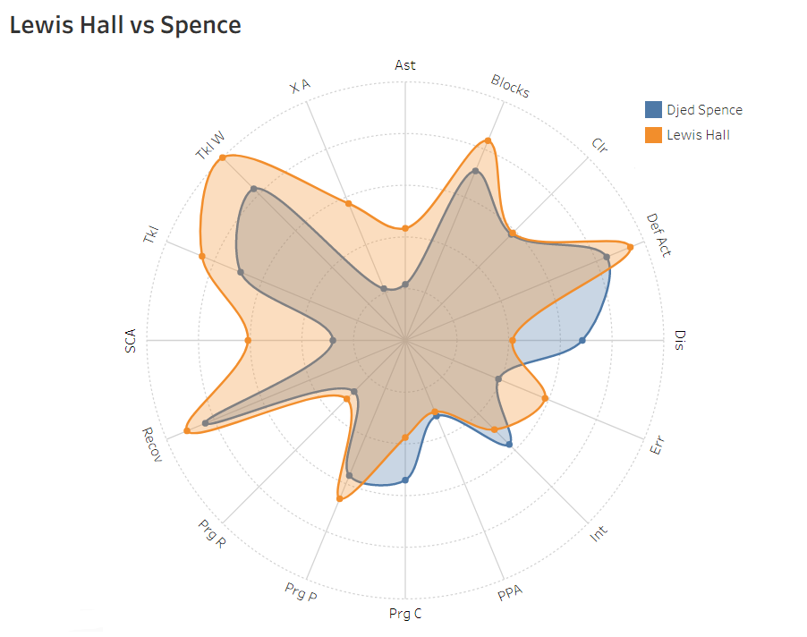
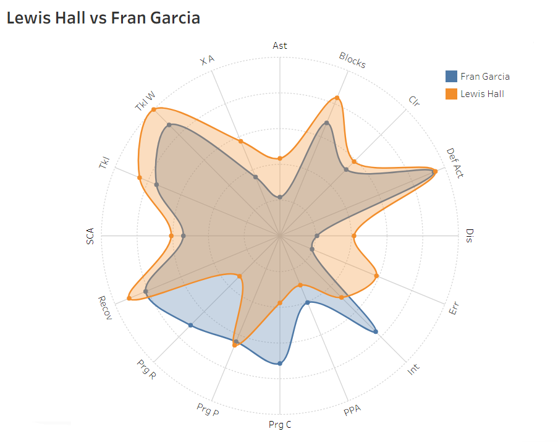
Radar Chart comparison of Shortlisted Leftbacks
Hall offers composure and progression, Spence adds pace and 1v1 threat.
Hall stronger in buildup play, García more aggressive in final third.

Slide 11
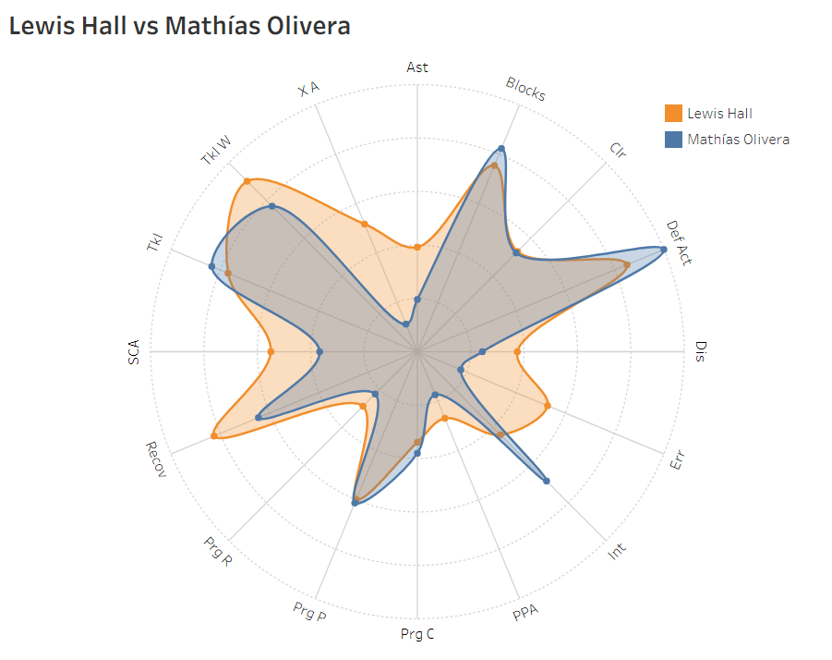
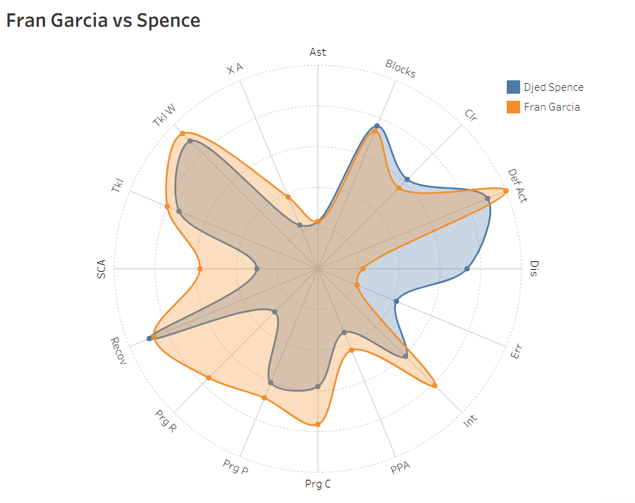
Radar Chart comparison of Shortlisted Leftbacks
Hall provides long-term upside, Olivera brings defensive solidity right now.
García excels in overlaps and crosses, Spence better in isolation duels.

Slide 12
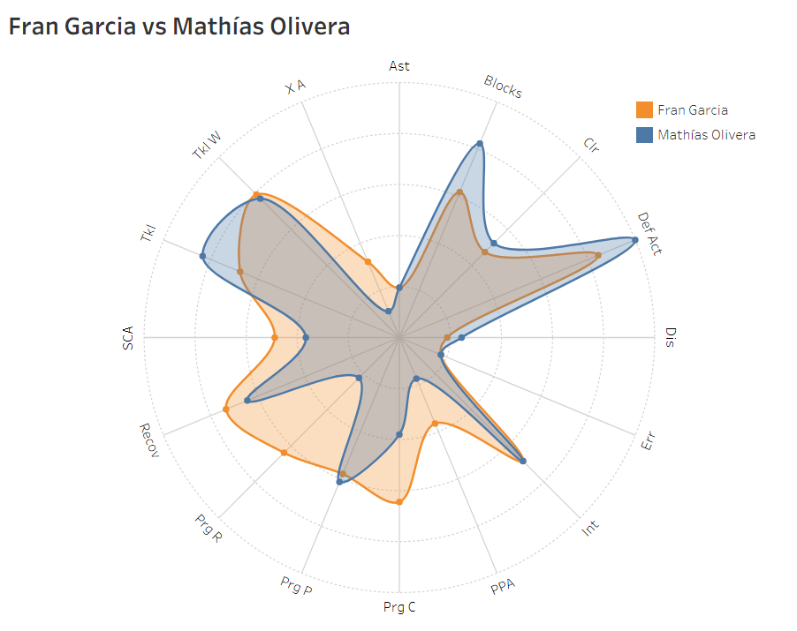
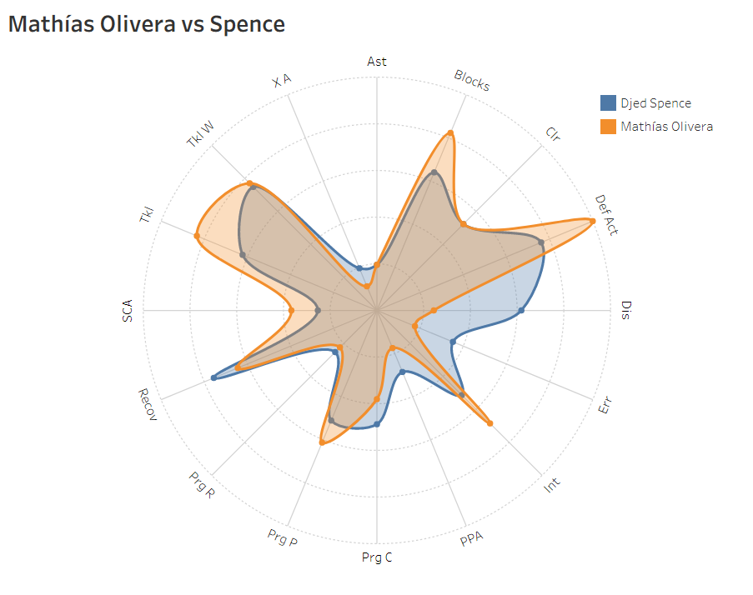
Radar Chart comparison of Shortlisted Leftbacks
García offers attacking energy, Olivera ensures balance and reliability.
Olivera fits structured defending, Spence is riskier but dynamic going forward.

Slide 13
Final Recommendation for Leftback
All four players are good but Lewis Hall is the most suitable because
Versatility: Can play LB and LCM providing depth across multiple positions.
Modern profile: Progressive carries, ball retention, and press resistance suit Bayern’s high-possession, high-line system.
Bayern already have an established starter at LB, Hall is a low-risk rotational option who won’t demand immediate starts, but still offers quality when rotated in.
Hall’s wages are lower relative to Olivera or García, making him a financially smart signing.
At Bayern Münich he would earn around 2m per year.
Loan with a mandatory future transfer fee reduces upfront financial burden.

Slide 14
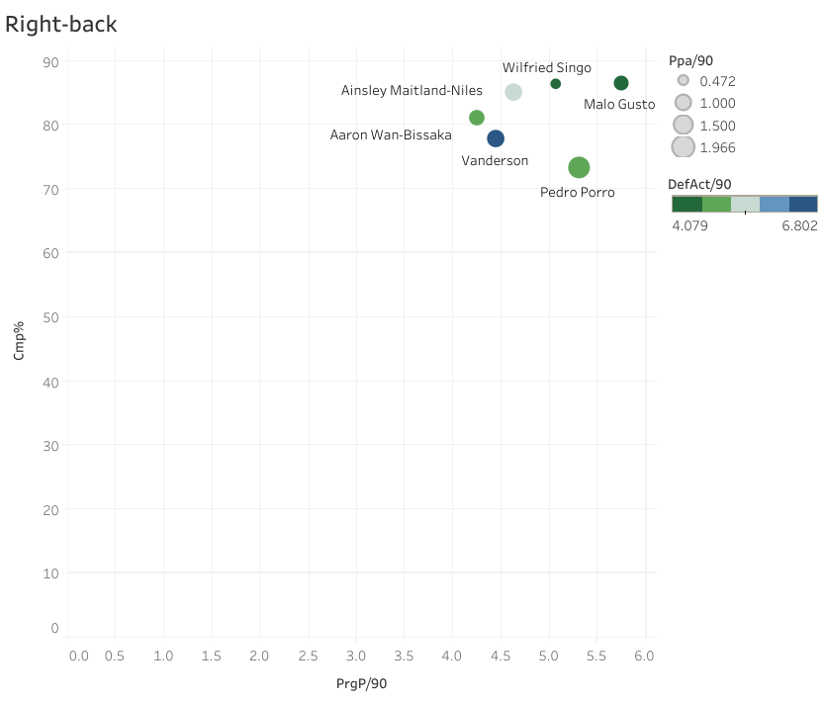
Elite Rightbacks
Using Scatter Plot to find all the elite rightbacks that can be an immediate starting option.

Slide 15
Shortlisted Rightbacks
Out of all available rightbacks, these are identified as a transfer targets:
Malo Gusto (22, Chelsea): Dynamic, modern RB with excellent progressive carries and crossing, still developing defensively and decision making in deeper areas
Wilfried Singo (24, AS Monaco): Physical, athletic fullback who doubles as a wingback or even CB in a back three. Offers strong ball carrying and defensive duels but limited in final third.
Pedro Porro (25, Tottenham): Attacking-minded rightback with elite progressive passing, xA, and final third involvement. Defensive solidity is his weakness, but tactically valuable as a hybrid wingback/playmaker.
Vanderson (24, AS Monaco): Balanced profile, contributes in both defense and attack with good ball security. Not as explosive as other fullbacks but reliable, versatile and tactically flexible.

Slide 16
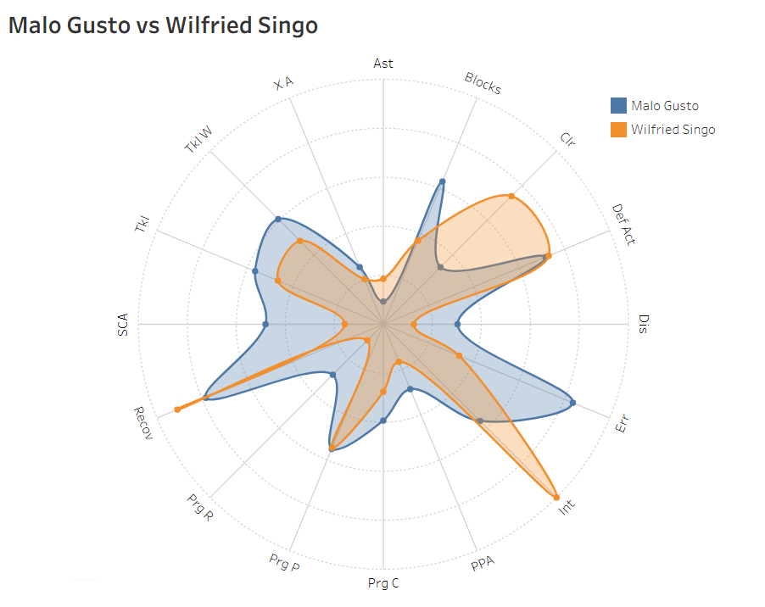
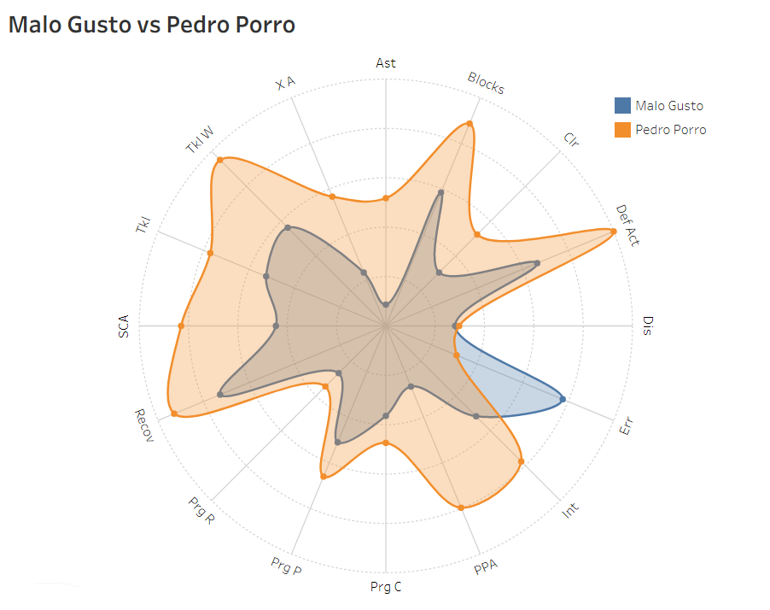
Radar Chart comparison of Shortlisted Rightbacks
Gusto offers higher creativity and dribbling numbers, Singo outperforms in physical duels and defensive metrics.
Porro outshines Gusto across nearly all areas, standing out as the all-round RB option.

Slide 17
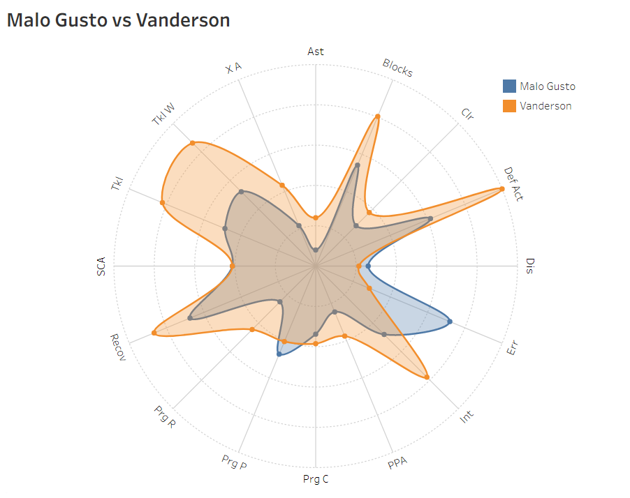
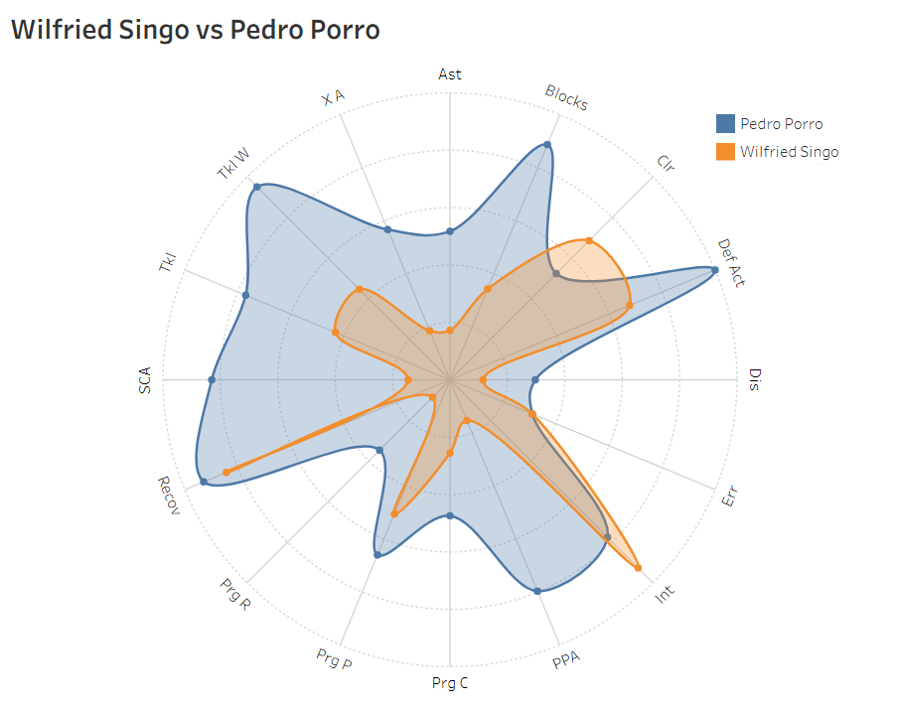
Radar Chart comparison of Shortlisted Rightbacks
Vanderson edges Gusto in almost every category, offering stronger balance between defence and buildup play.
Wilfried Singo dominated physically and defensively, while Porro creates far more in attack, progressive passing and xA.

Slide 18
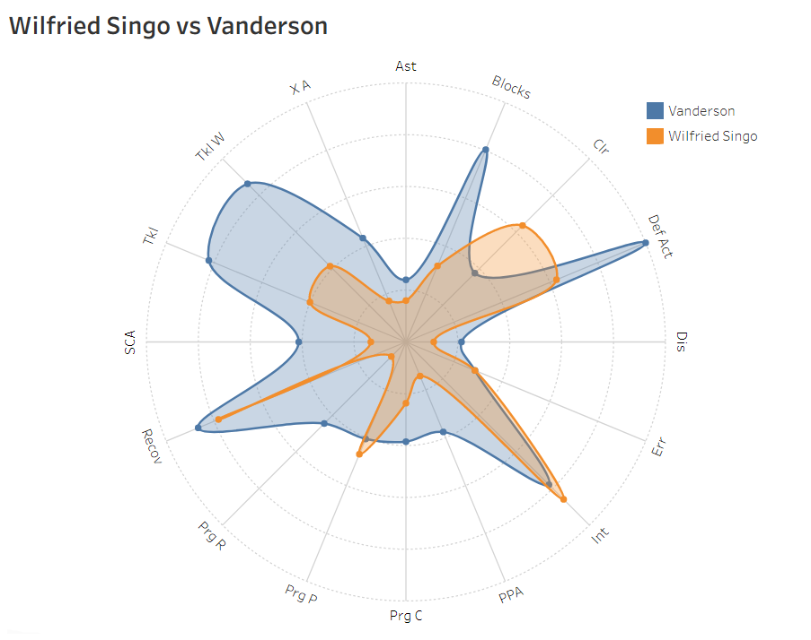
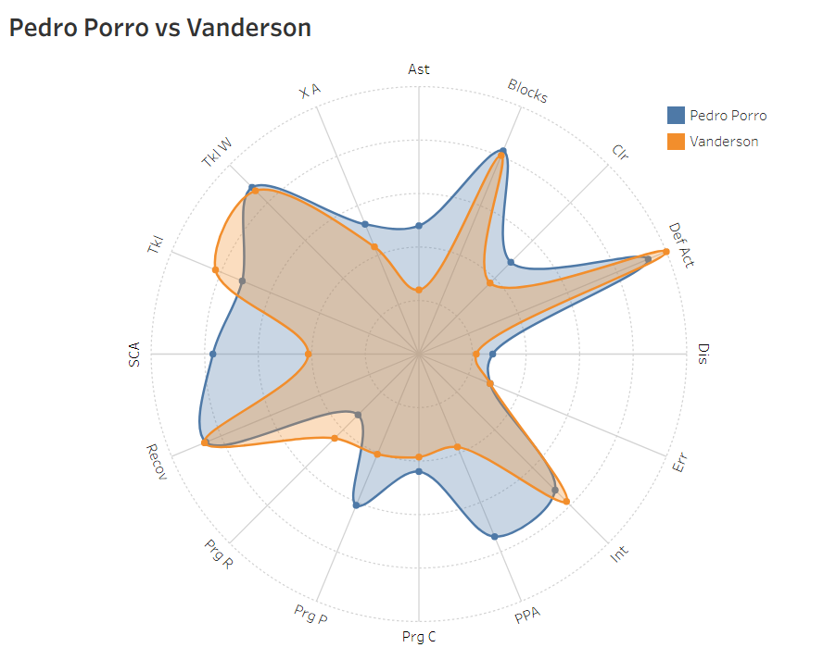
Radar Chart comparison of Shortlisted Rightbacks
Singo offers better progressive passing and duels, Vanderson is more balanced in passing and involvement in buildup.
Porro offers high-end creative threats in the final third, Vanderson is a safer balanced defender

Slide 19
Final Recommendation for Rightbacks
Out of all four candidates, Pedro Porro and Vanderson stood out the most
1. Pedro Porro (Tottenham)
Offers the closest to elite attacking output among the shortlisted RBs, outstanding progressive passing, xA, and shot-creating actions.
Provides an immediate attacking boost from deep and wide areas, maintaining Bayern’s dominance in possession.
A transfer would cost roughly 40m.
At Bayern Münich he would earn around 4m per year.
2. Vanderson (AS Monaco)
A more balanced and reliable profile, outperforming most RBs in defensive and buildup metrics
Brings in tactical flexibility, lower error frequency and consistency, making him a safer rotational option.
A transfer would cost roughly 30m.
At Bayern Münich he would earn around 4m per year.

Slide 20
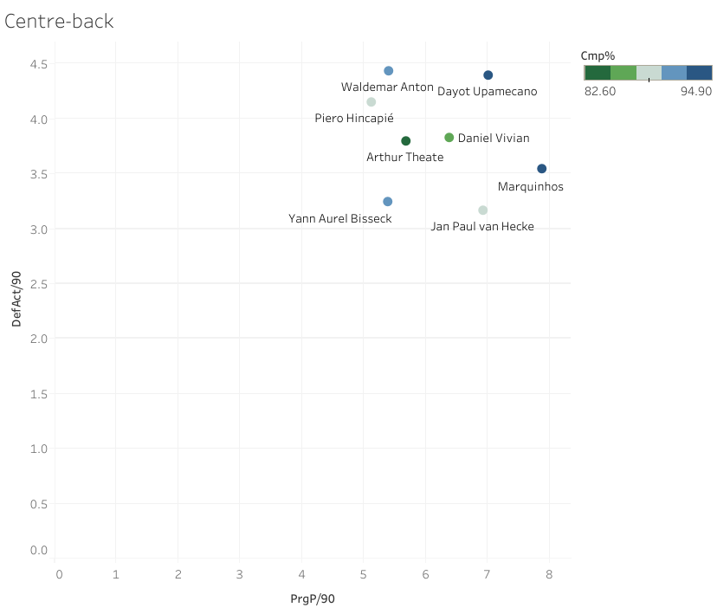
Elite Centrebacks
Using Scatter Plot to find all the elite centrebacks that can be a rotational option.

Slide 21
Shortlisted Centrebacks
Out of all available centrebacks, these are identified as a transfer targets:
Piero Hincapié (23, Leverkusen): Quick, left-footed, centreback comfortable in buildup, excels in anticipation and recovery defending.
Waldemar Anton (29, Dortmund): Experienced, physically strong defender with leadership qualities, reliable in duels and aerial battles.
Daniel Vivian (26, Athletic Bilbao): Aggressive, proactive ball-winner, brings intensity and strong man-marking ability at the back.

Slide 22
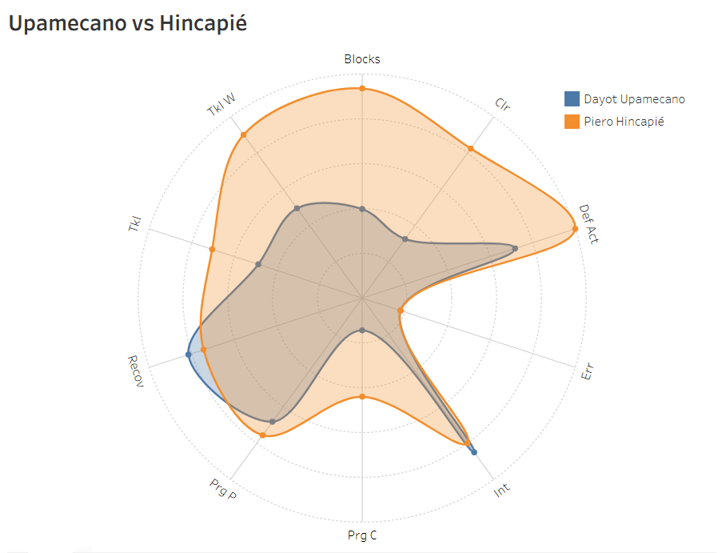
Radar Chart comparison of Shortlisted Centrebacks
Hincapié shows stronger ball progression and recovery speed, he is good in buildup and can provide balance at left centreback spot.

Slide 23
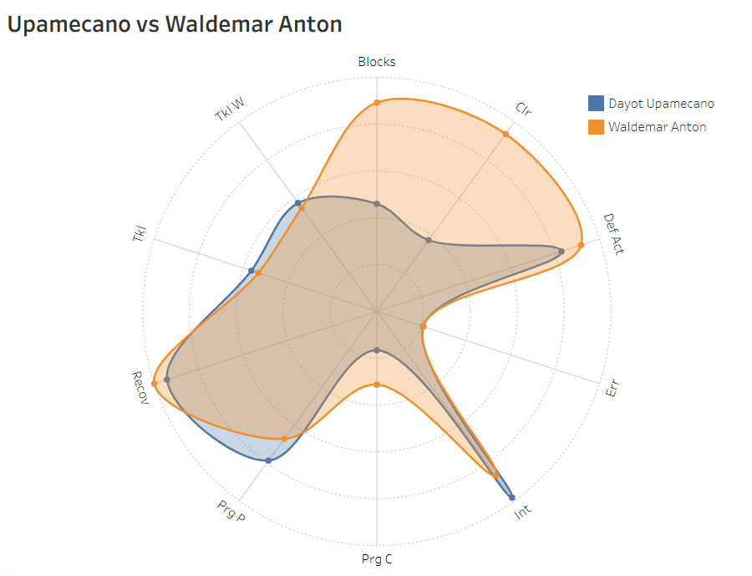
Radar Chart comparison of Shortlisted Centrebacks
Waldemar Anton excels in defensive and aerial duels but offers less ball progression compared to Upamecano. Chart reflects him as a safer, more traditional stopper.

Slide 24
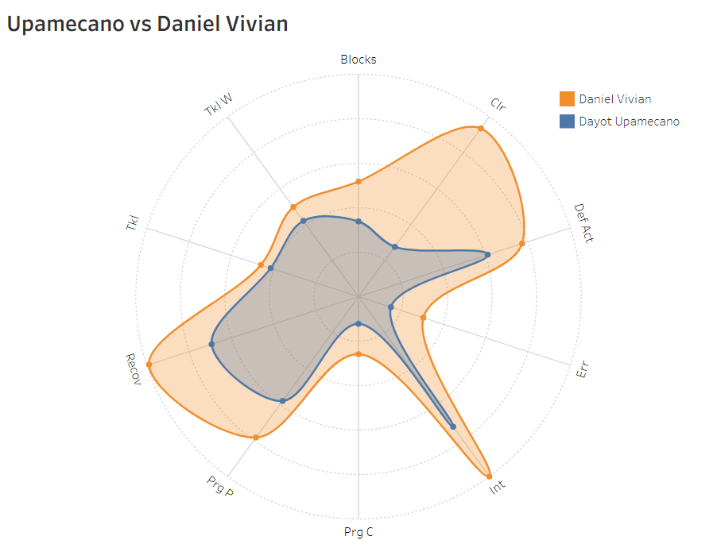
Radar Chart comparison of Shortlisted Centrebacks
Daniel Vivian stands out for his aggression, interceptions and man-marking intensity and shows a defence first profile. The chart underlines him as a standout performer.

Slide 25
Final Recommendation for Centreback
All three players are good but Piero Hincapié is the most suitable because
Left-footed, giving a natural balance at LCB
Comfortable playing a high-intensity, pressing team and praised for his recovery ability
Also plays as leftback, giving you more tactical flexibility and smooth short-passing integration from the left.
A move to Bayern Münich would bump up his salary to roughly 4m per year.
There is a 60m release clause in his contract, but a loan with a mandatory future transfer fee reduces upfront financial burden.

Slide 26
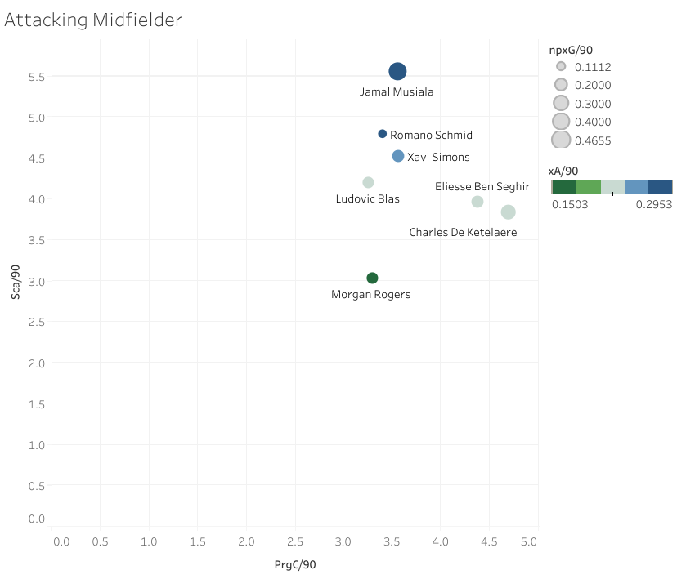
Elite Attacking Midfielder
Using Scatter Plot to find all the elite Attacking midfielders that can be a rotational option.

Slide 27
Shortlisted Attacking Midfielders
Out of all attacking midfielders available, these two are identified as transfer targets.
Romano Schmid (25, Werder Bremen): Industrious attacking midfielder who contributes through link up play, ball retention, and defensive work rate. Reliable squad option but offers less direct goal threat and final-third creativity compared to elite AMs.
Xavi Simons (22, RB Leipzig): Dynamic, versatile creator with strong progressive carries, passing and chance creation. Adds direct attacking threat while covering multiple roles (LW, AM, RW) making him a high upside, like-for-like backup for Musiala.

Slide 28
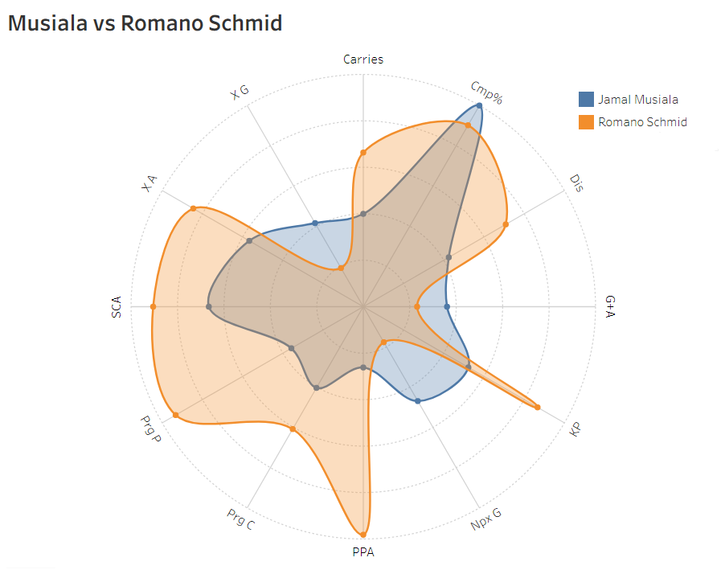
Radar Chart comparison of Shortlisted Attacking Midfielder
More of a workhorse wide/AM profile. Radar shows more passes/crosses but noticeable lower on non-penalty goals and pass completion percentage.

Slide 29
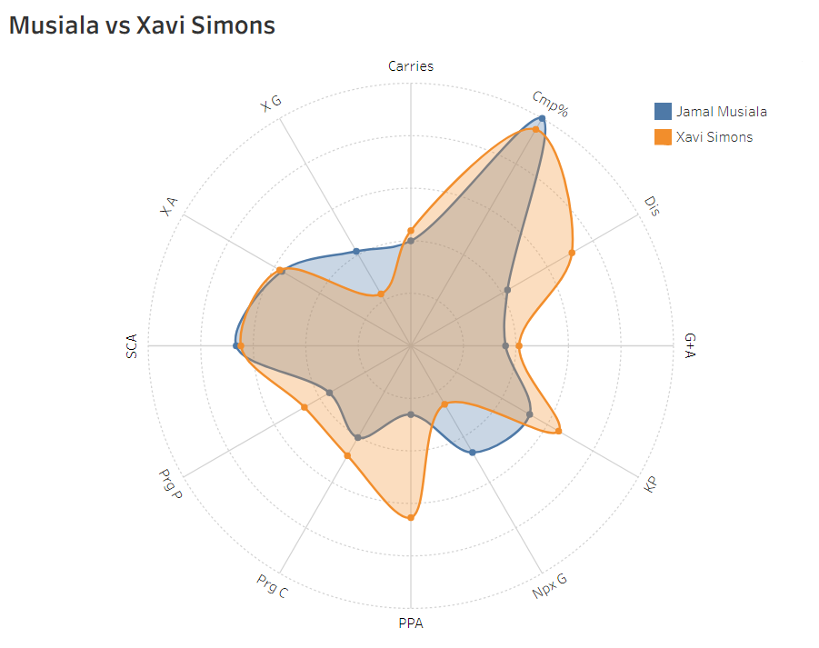
Radar Chart comparison of Shortlisted Attacking Midfielder
Radar shows strong progressive passing and chances created but lower pure finishing number than Musiala. He’s creative and direct but less lethal in the box.

Slide 30
Final Recommendation for Attacking Midfielders
Both the targets are good but Xavi Simons is the most suitable because
Beyond replicating Musiala’s directness, progressive actions and chance-creation in the final third, Simons offers consistent end-product at the top level (double digit G+A at PSV and RB Leipzig)
Offers elite pressing intensity that suits Bayern’s philosophy.
Can provide coverage on left wing as well, adding to the attacking depth of the squad.
At 22, he represents both an immediate squad upgrade and long-term asset
50m price set by RB Leipzig for Bayern Münich. He would earn around roughly 7m per year at Bayern Münich.

Slide 31
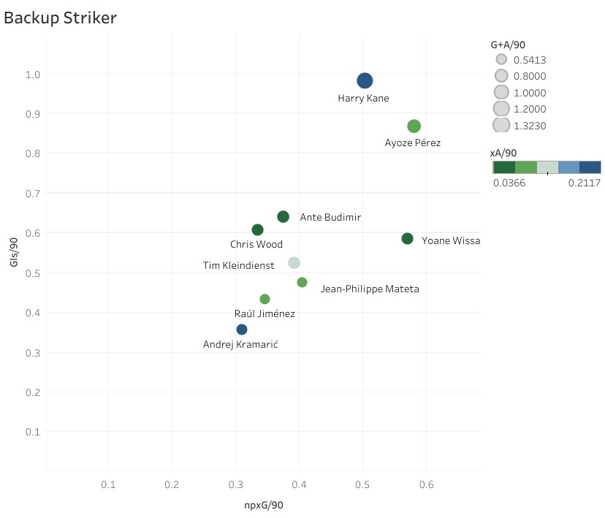
Backup Strikers
Using Scatter Plot to find all the strikers that can be a backup option to Harry Kane.

Slide 32
Shortlisted Strikers
Out of all strikers available, these four are identified as transfer targets.
Ayoze Perez (32, Villarreal): A versatile forward who combines scoring output with creative playmaking, capable of linking midfield and attack. His strong G/90 and xA/90 make him an effective dual-threat option.
Ante Budimir (34, CA Osasuna): A classic poacher with smart positioning and consistent scoring efficiency. He thrives in converting chances and maintaining a steady G/90 output.
Tim Kleindienst (29, Borussia Mönchengladbach): A reliable target man who offers physical presence and finishing ability inside the box. His balanced npxG and goal rate show he can be a dependable poacher-type option.
Chris Wood (33, Nottingham Forest): An experienced striker with strong aerial ability and hold-up play. His steady G/90 reflects reliability as a backup who can impact games physically.

Slide 33
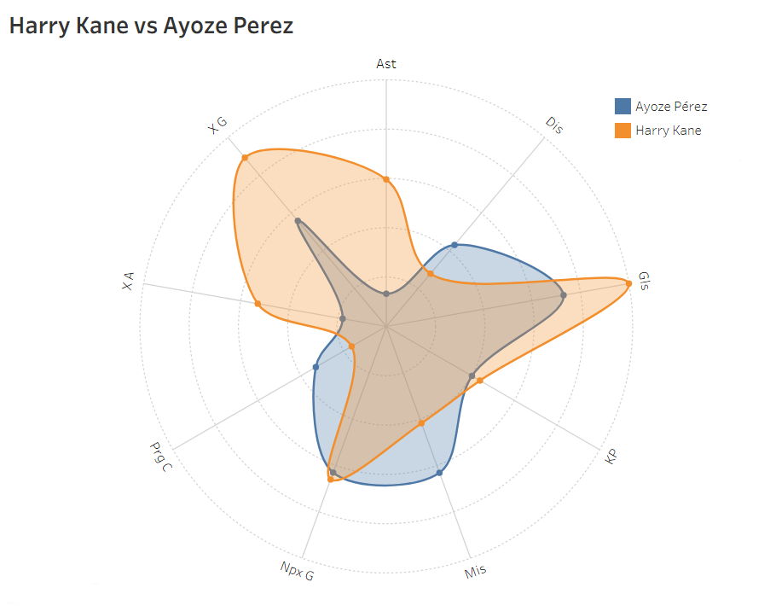
Radar Chart comparison of Shortlisted Strikers
Kane dominates overall output with higher goalscoring and involvement, but Pérez provides stronger progressive carries and a similar goal threat in the buildup (npxG). This makes him a different type of option rather than a pure Kane replacement

Slide 34
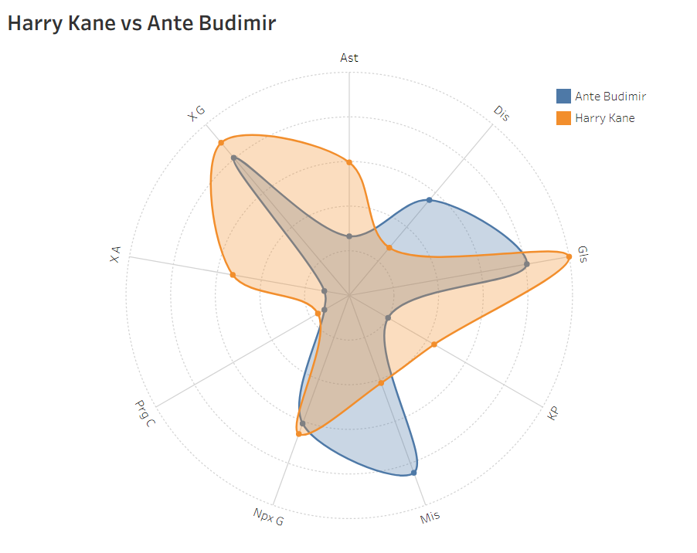
Radar Chart comparison of Shortlisted Strikers
Kane leads in most attacking metrics, but Budimir shows closer parity in pure goalscoring efficiency. Budimir’s reliability inside the box makes him the closest “poacher” alternative to Kane.

Slide 35
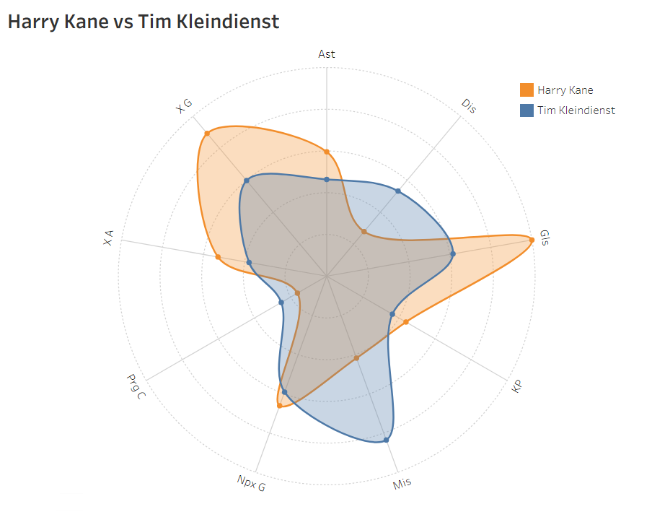
Radar Chart comparison of Shortlisted Strikers
Kleindienst offers a more traditional target man profile with decent scoring numbers, though Kane’s all-round attacking contribution far surpasses him. He can replicate some goal output but not Kane’s creative link-up.

Slide 36
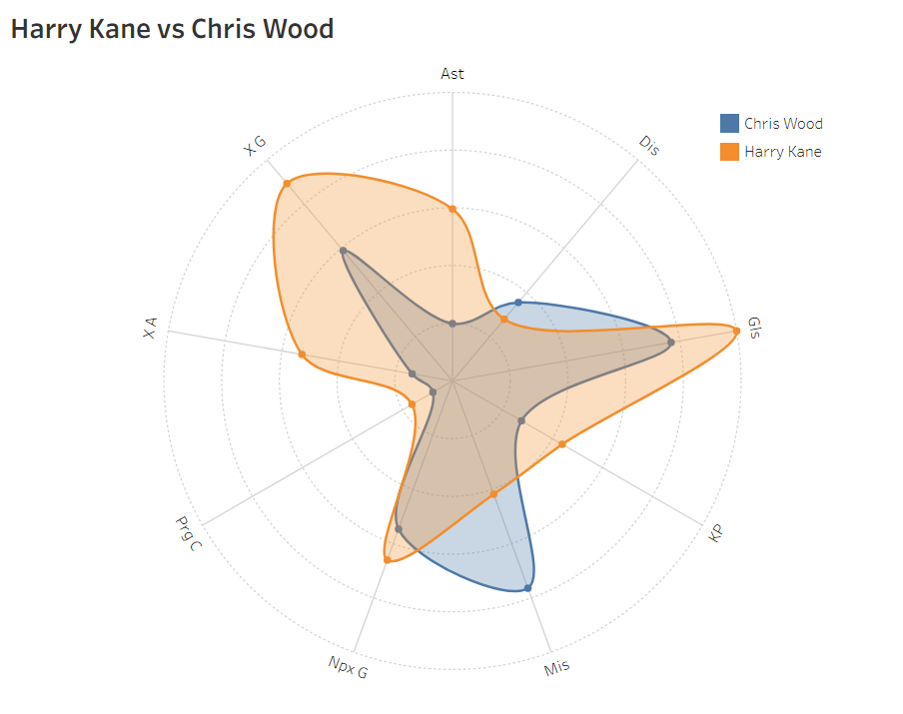
Radar Chart comparison of Shortlisted Strikers
Wood brings physical presence and steady scoring, though his metrics sit below Kane across the board. He profiles more as a situational backup who can provide aerial threat and hold-up play.

Slide 37
Final Recommendation for Backup Striker
Out of all the targets Ayoze Perez seems the best fit
Ayoze can cover wide areas or play off Kane, making him more useful in a squad rotation context.
Higher xA numbers show he adds playmaking, not just finishing. If Kane is rested rather than absent, Ayoze could still slot in and complement Bayern’s other attackers in a different way.
At 32, he still has 2–3 reliable seasons ahead, making him a smart medium-term solution as Harry Kane’s backup while also offering adaptability across the frontline.
A transfer would cost in the range of 10m. At Bayern he would earn around 3.5m per year.

Slide 38
Final Transfer Recommendations
Name | Position | Market Value | Salary Gross (p/y)
Lewis Hall | LB | 6m loan | 3.8m
Pedro Porro/Vanderson | RB | 30-40m | 7m
Piero Hincapié | CB | 9m loan | 7.7m
Xavi Simons | AM | 50m | 12m
Ayoze Perez | ST | 10m | 6.7m
Total |  | 105-115m | 44.4m

Slide 39
Integrating Youth Academy
Last major breakthrough: Jamal Musiala (2020/21, 870 minutes)
Since then, the youth is mostly loaned out (Austria, German 2nd/3rd tier) with limited first-team impact.
Current promising talents: Lennart Karl, Wisdom Mike, Jonah Kusi-Asare.
Breakthrough seasons are crucial for both player development and long-term squad sustainability.
Youth integration would mean lower wage burden and improved squad depth.

Slide 40
Projected Minutes for Youth
Correct utilisation of youth talent can deliver valuable minutes this season, especially in Pokal and UCL group-stage fixtures. This approach both protects senior players from fatigue and accelerates the pathway of Bayern’s next generation into the first team.
Name | Position | Realistic Minutes | Rationale
Lennart Karl | RW, CAM | 1200-1500 | Only RW backup to Olise + CAM cover while Musiala is injured
Wisdom Mike | LW | 600-800 | Luis Diaz starter, inconsistent Gnabry means a real chance of rotation
Jonah Kusi-Asare | ST | 500-700 | Kane + Ayoze ahead, but minutes in Pokal and late substitutions

Slide 41
Final Financial Outcome
Transfers
Transfer Budget Generated from sales: 142.95m
Transfer Budget spend on recruitment: 115m
Net transfer spend:～28m
Wages (Gross per year)
Initial Wage Budget: 303.2m
Wage budget free from player departures: 93.01
Total wages of new signings: ～29m
Expected wage budget: 242.56m
Final wage budget: 239.19m

Slide 42
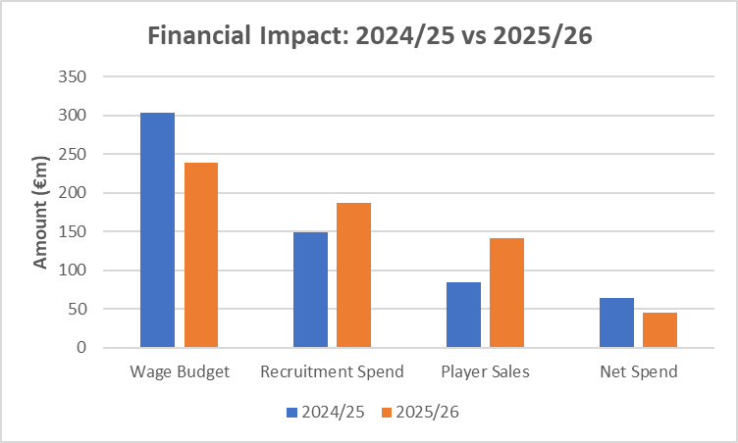
Financial Impact
Bayern achieved a 21% wage budget reduction while improving sales and controlling net spend.
Financial efficiency improved: lower wage bill, higher player sales, and reduced net spend.
2025/26 marks a leaner, more sustainable financial structure compared to 2024/25.

Slide 43
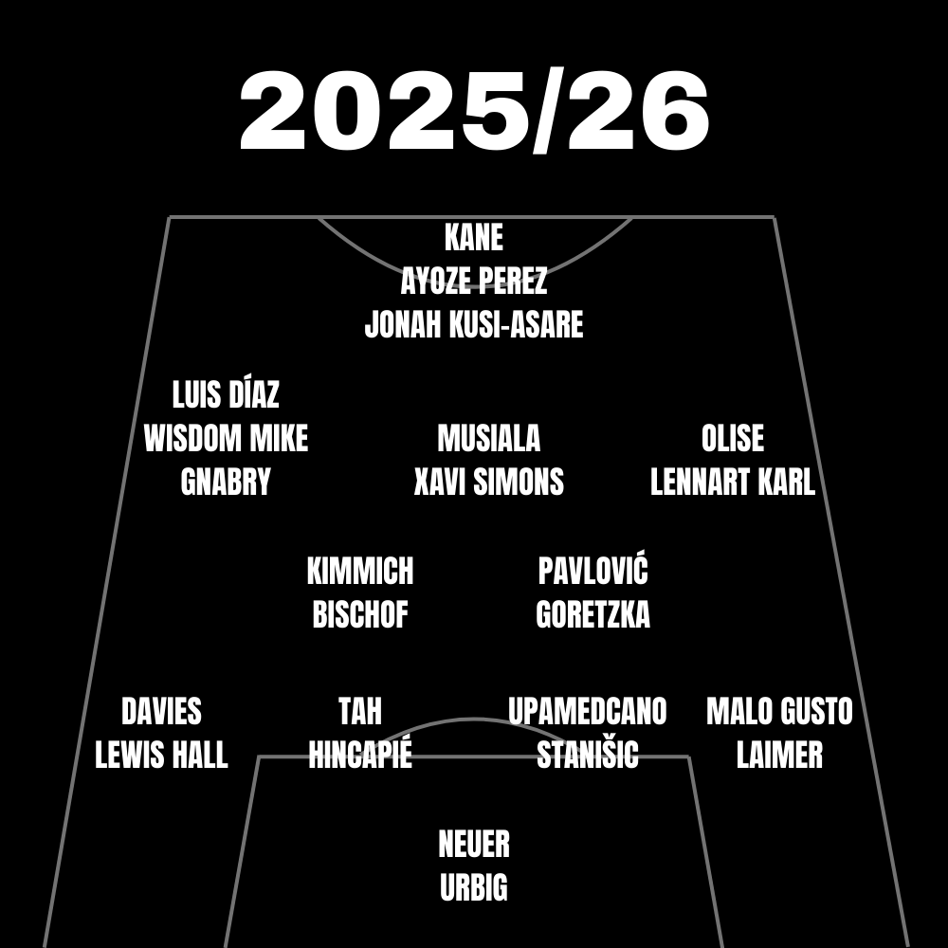
Projected Lineup
Projected 2025/26 squad composition highlights the integration of key signings and targeted sales, balancing experience with youth while maintaining tactical flexibility.

Slide 44
Conclusions
Next Steps
Achieved 20% reduction in wage budget
Integrated Youth academy players
Improved squad depth via player recruitment and youth promotion.
Monitor performances to ensure smooth integration of signings and youth.
Phase in high-potential talents through league and cup games.
Reassess wage budget and transfer plans mid-season.
Use squad flexibility to adapt tactics in UCL and key matches.
Track undervalued players for future windows.

